Slide 1
History Of Computers
Chapter: 2

Slide 2
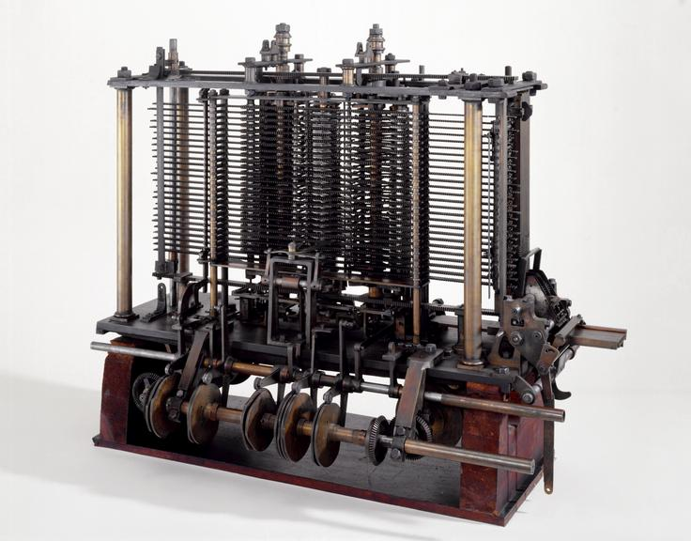
History Of Computers
Invented to resolve numbering crisis.
Tabulation of 1880 US Census led to invention.
Invented by Charles Babbage in 1822.
Herman Hollerith designed punch card and formed IBM later.
Alan Turing presented universal machine in 1936.

Slide 3
Tabular Description Of History Of Computers
Inventor | Type | Functions
Charles Babbage | Difference Engine | A steam-driven mechanical computer capable of performing simple calculations.
Charles Babbage | Analytical Engine | Automated equipment that uses punch cards as input Capable of solving mathematical problems and also storing information as a permanent memory.
Herman Hollerith | Tabulating Machine | An improvement on the mechanical computers by Charles Babbage and uses punch cards as input and can tabulate statistics, while recording and sorting data.
Vannevar Bush | Differential Analyzer | An analog device, the first electronic computer uses vacuum tubes to switch electrical signals for performing calculations capable of performing up to 25 calculations in short time.

Slide 4
The First Generation
First generation during 1937 to 1946.
Introduction of the world's first electronic digital computer in 1937.
ABC (Atanasoff Berry Computer) by Dr. John V Atanasoff and Clifford Berry.
First electronic computer for military in 1943.
Inventor | Type | Functions
Howard Aiken | Calculating Machine | Developed to perform calculations involving large numbers.
IBM and Harvard | Mark I Computer | The first programmable digital computer.
John Mauchly and J. Presper Eckert | ENIAC EDVAC | The first general-purpose digital computer. Designed as a stored-program computer working on binary rather than decimal.

Slide 5
The Second Generation
Second generation during 1947 to 1962.
First commercial computer, Universal Automatic Computer (UNIVAC 1) in 1953.
Introduction of IC’s, COBOL and FORTRAN.
Popular second generation computers are:
IBM 1620
IBM 7094
CDC 1604
CDC 3600
UNIVAC 1108

Slide 6
The Third Generation
Third generation during 1963 to 1980.
Bell labs invested first operating system, UNIX in 1969.
World’s first DRAM by Intel 1130 in 1970.
Led to invention of floppy and Ethernet.
Also called Golden period.
IBM stared manufacturing mainframe computers.
Individual PC connect to mainframe for networking.
Mainframe computers acts as servers.
Popular third generation computers are:
IBM 360 Series
Honeywell 6000 Series
Personal Data Processor – PDP
IBM 370/168
TDC 316

Slide 7
Present Generation
From 1981 onwards.
World’s first personal computer, Acorn, in 1981 by IBM.
Worked on MS- DOS operating system.
First PC with GUI in 1983 by Apple called Lisa.
Lisa later become Macintosh.
Portable computer Gavilan SC, later laptop in 1983.
March 15, 1985, was a red-letter day, registration of first dot-com domain.
Tim Berners Lee develop HTML in 1990.
Pentium processors in 1993 and gaming machines in 1994.
Google search engine b Larry Page and Sergey Brin in 1996.
Wi-Fi in 1997.
Windows XP and MacOS in 2001.
First 64-bit processor in 2003.

Slide 8
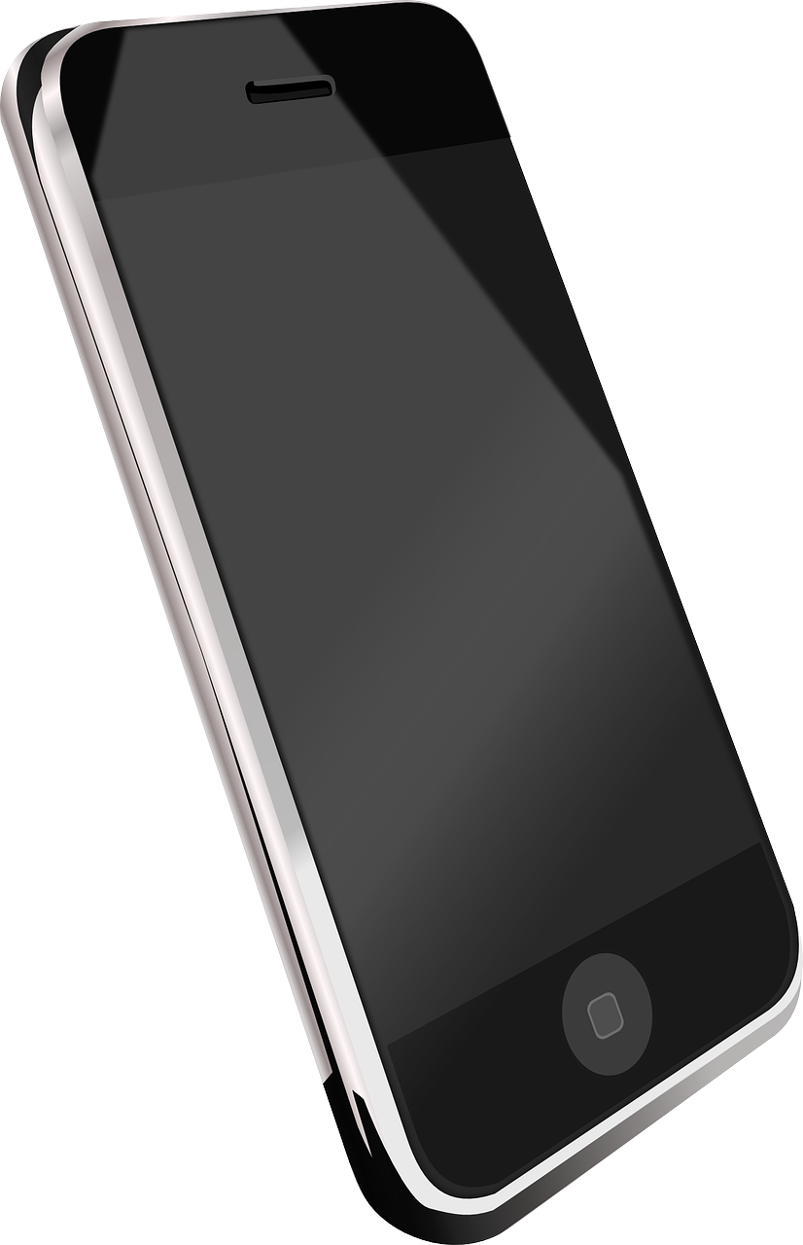
The Internet And Smartphone Revolution
Smartphones contain multiple ENIAC.
Perform sophisticated calculations quickly.
ENIAC with internet provide wider communication.
With present rate, technology will boom.
Present technology has brought people together.
Long way since Charles Babbage designed first system.

